Slide 1

Accenture – Detecting the Data Breach
AI Studio Final Presentation
Break Through Tech New York @Cornell Tech
Dec 6 2023

Slide 2

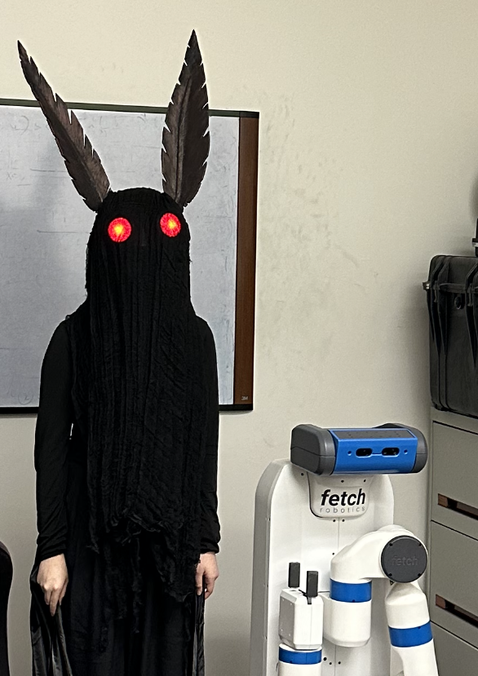

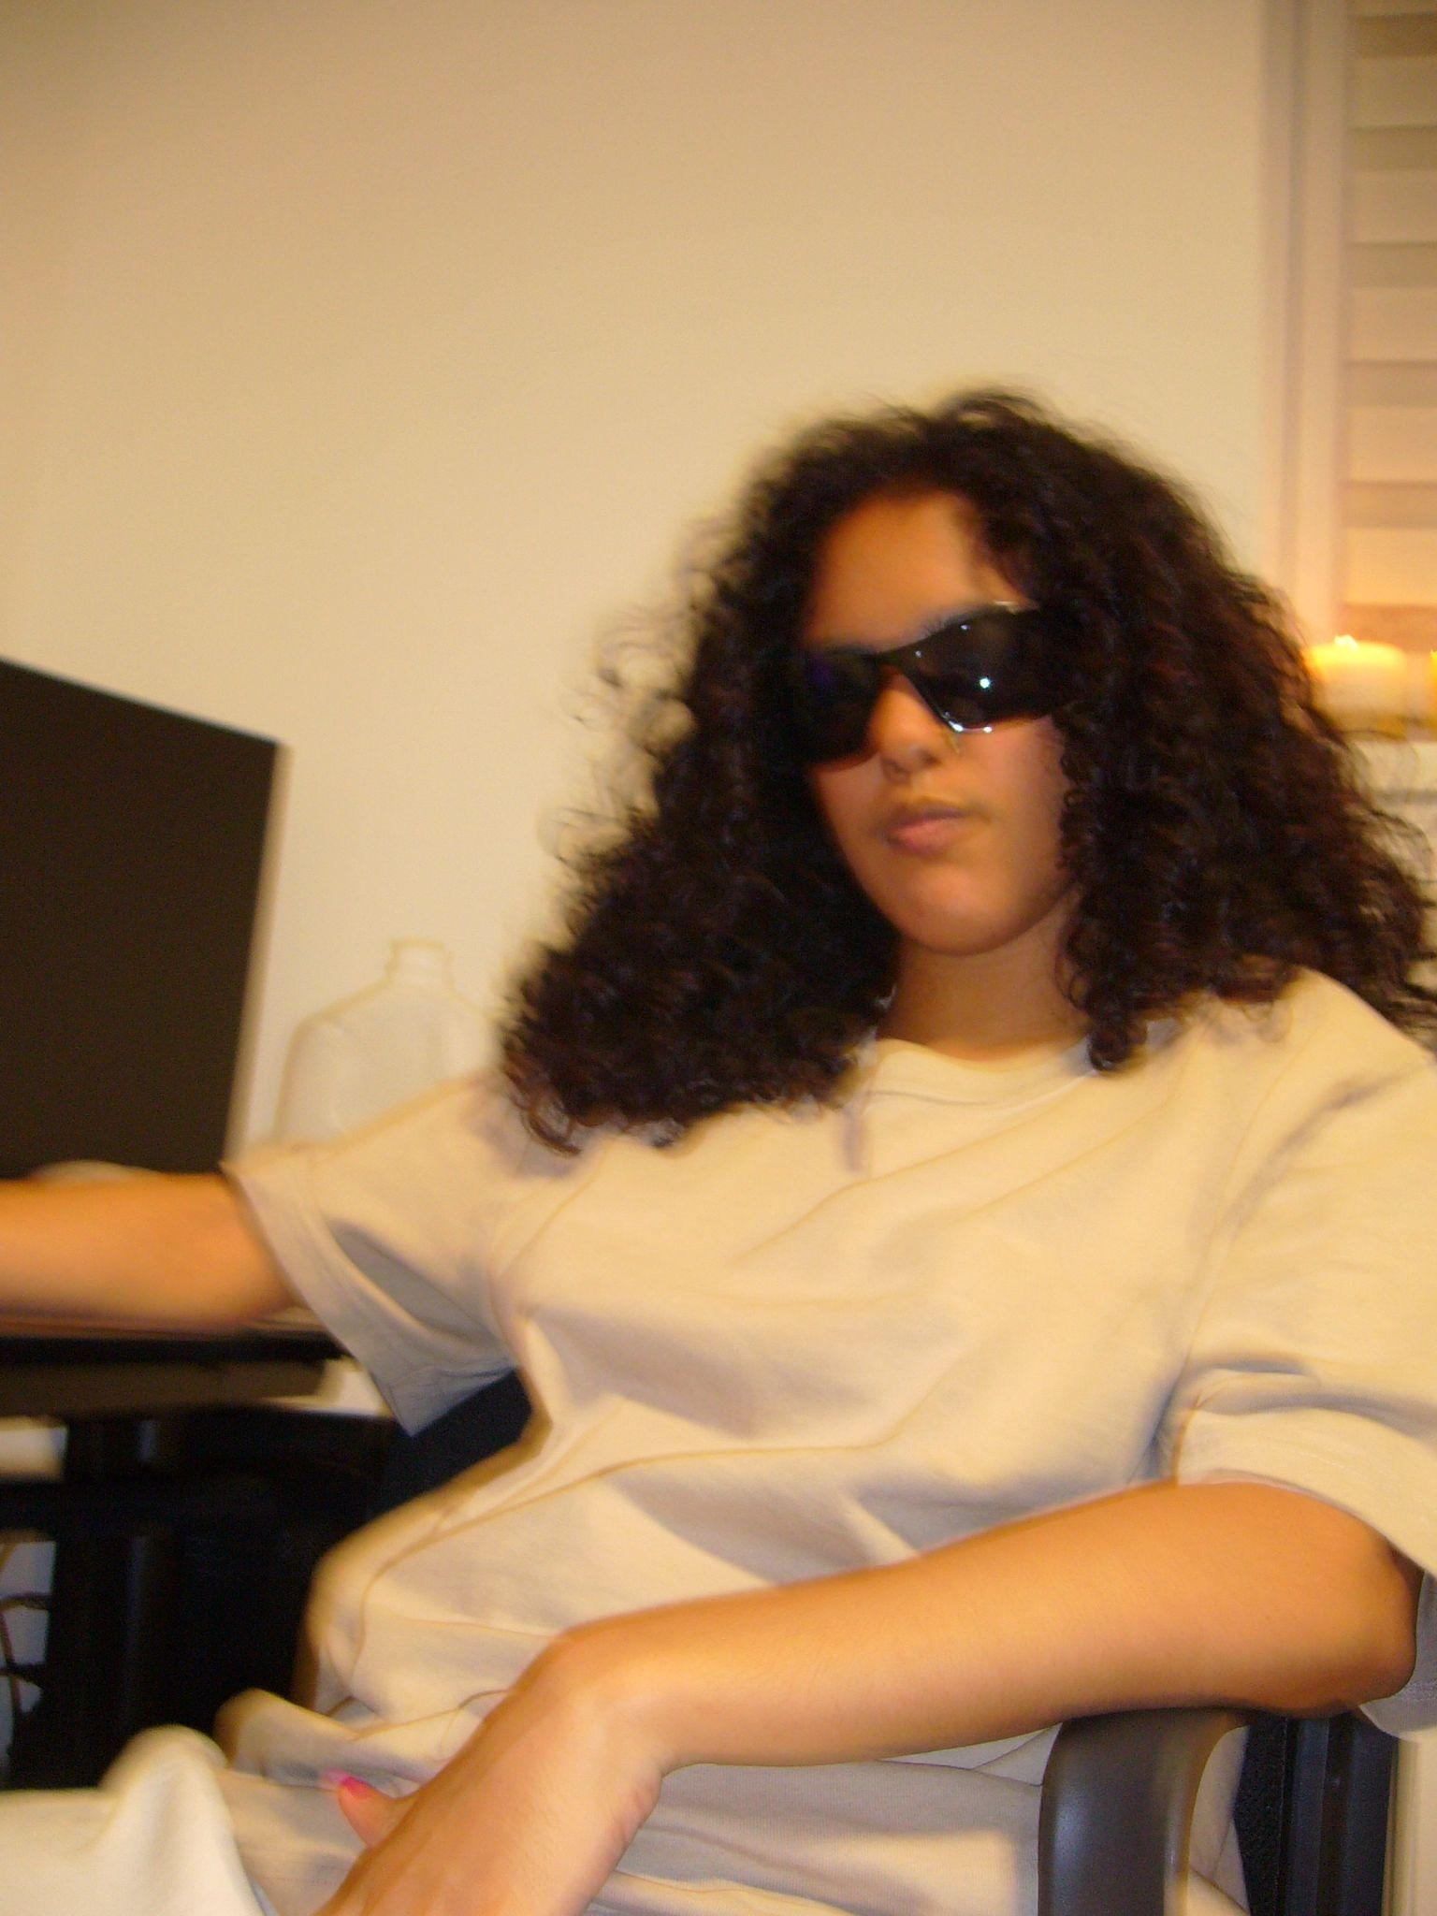

Our Team
Georgina Woo Hunter College
Ayan Das City College of New York
Urvi Bhatnagar
Stony Brook University
Maria Mercado
Hunter College
Notes:
Michelle

Slide 3

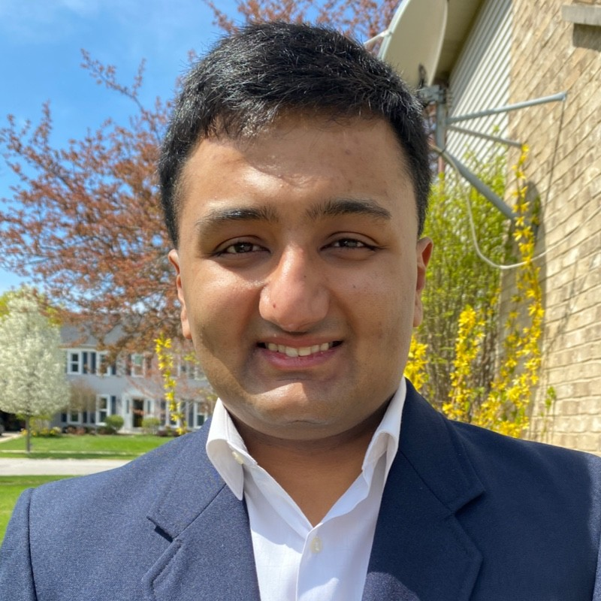

Our AI Studio TA and Challenge Advisors
<insert jpg>
<insert jpg>
<insert jpg>
Wenjie Wang AI Studio TA
Sanjay Ananthanarayan Challenge Advisor
Timo Budiono
Challenge Advisor
Notes:
Michelle

Slide 4
Presentation Agenda
The Problem Statement
The Timeline
The Data
Our Findings
Notes:
Urvi

Slide 5

“
As a data scientist with Accenture, you work with a top international healthcare company. Develop an ML algorithm that can identify how the next data breach will occur.
Notes:
Urvi

Slide 6

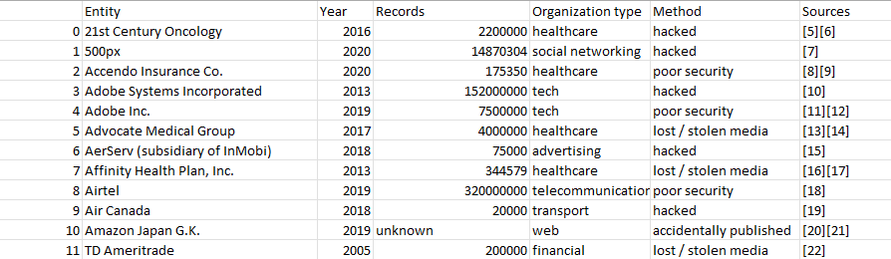
[Insert image and/or code snippet]
The Dataset
Accenture 3A - Ayan
Notes:
Ayan

Slide 7
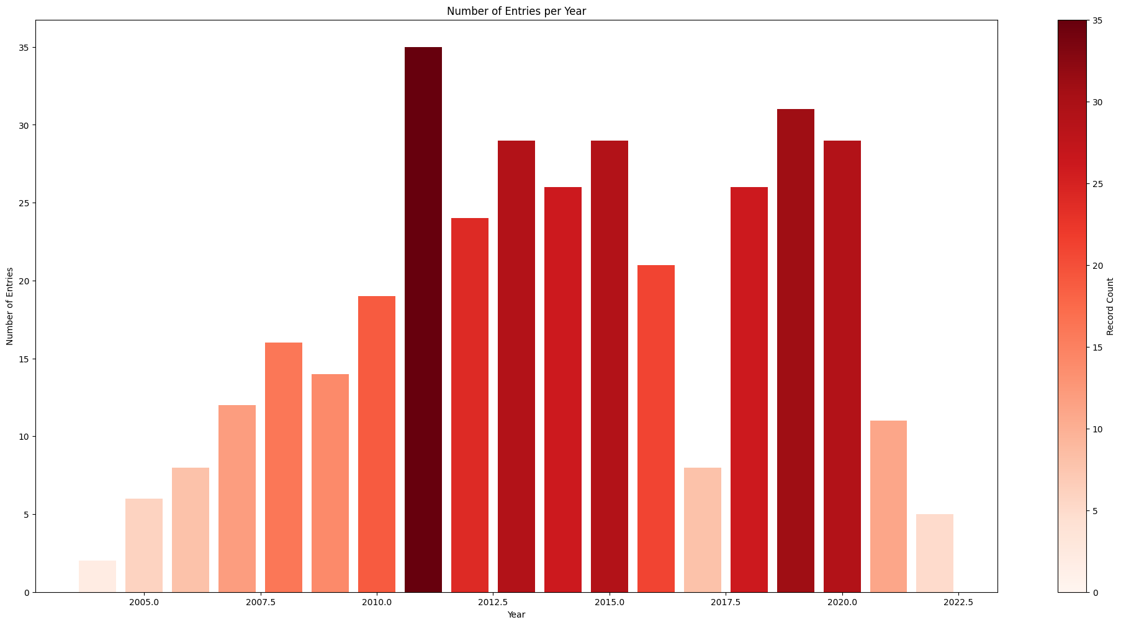
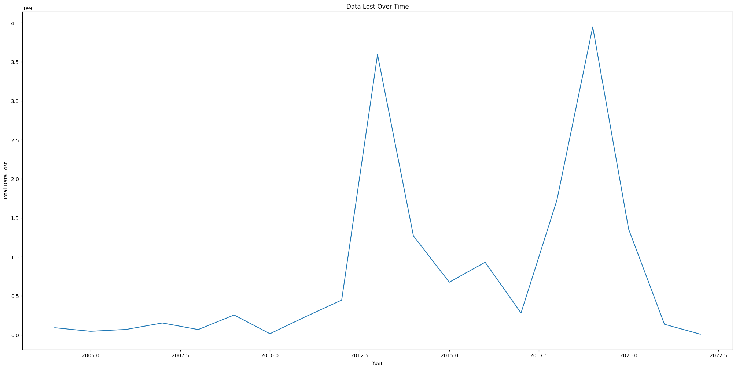
Accenture 3A - Ayan
Notes:
Ayan

Slide 8
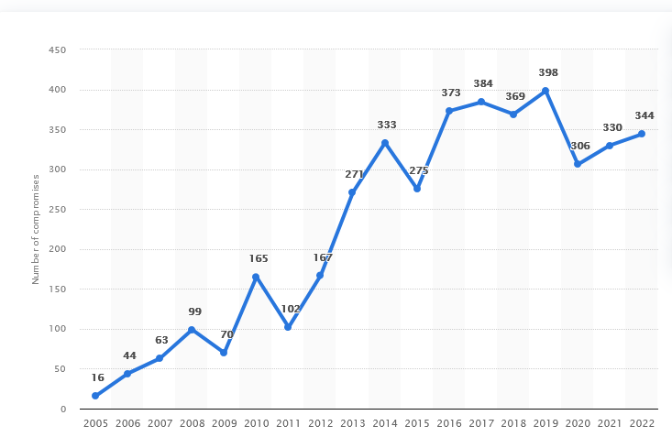
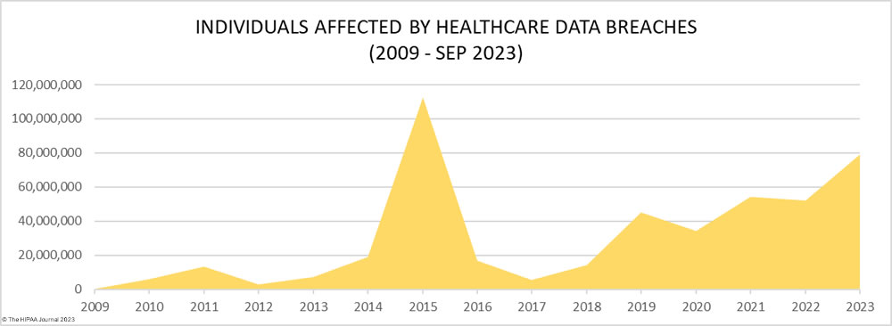
Healthcare Data Breaches
Accenture 3A - Georgina
Notes:
Ayan

Slide 9
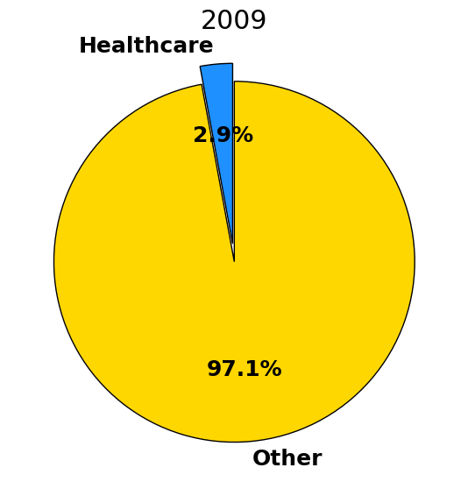
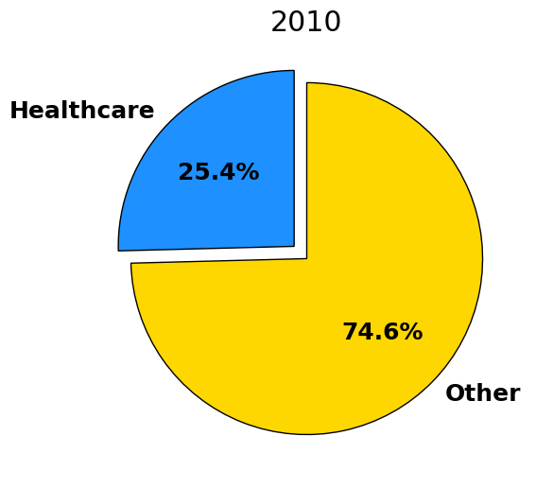
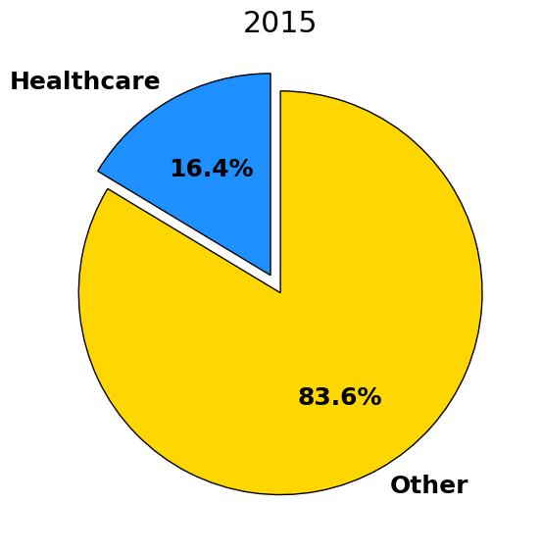
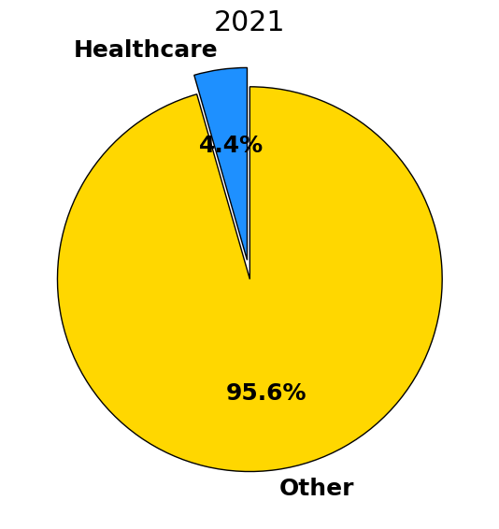
Our Healthcare Data
In Healthcare:
HIPAA guidelines and rules
Max $50k per record
Civil monetary penalties to individuals
Our Data:
No records lost in half of the years (2004-2022)
Significant years: 2010-11, 2015, 2021: 4 mil - 100 mil records lost
Accenture 3A - Georgina
Notes:
Georgina

Slide 10
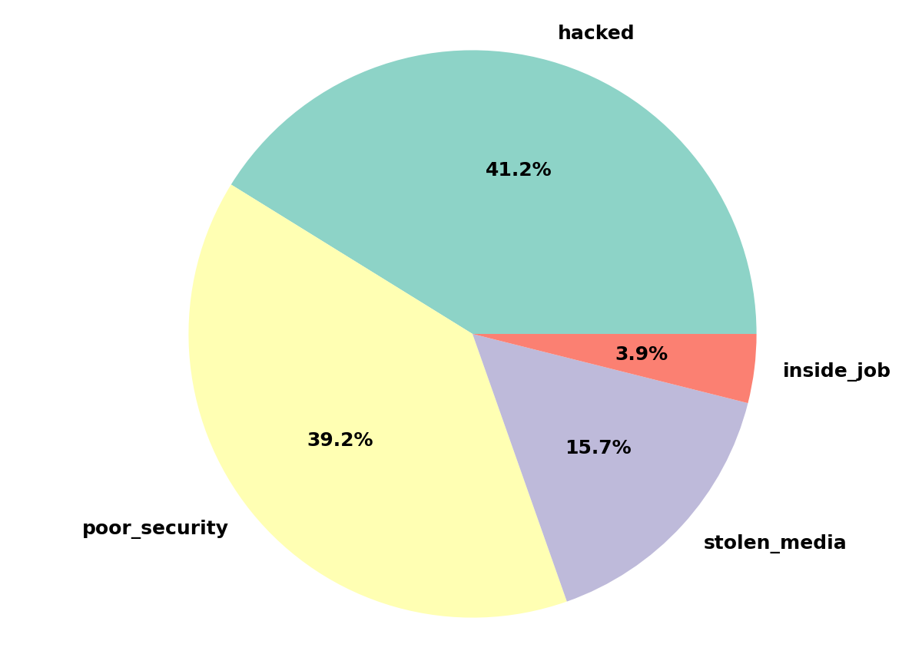
Causes of Healthcare Data Breaches
Accenture 3A - Georgina
Notes:
Georgina

Slide 11
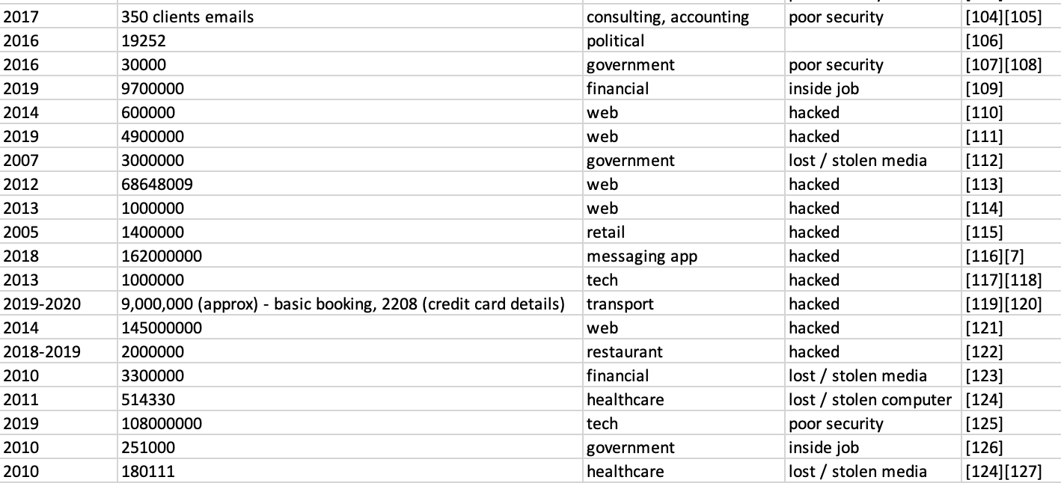
Data Cleaning
Accenture 3A - Georgina
Notes:
Georgina

Slide 12
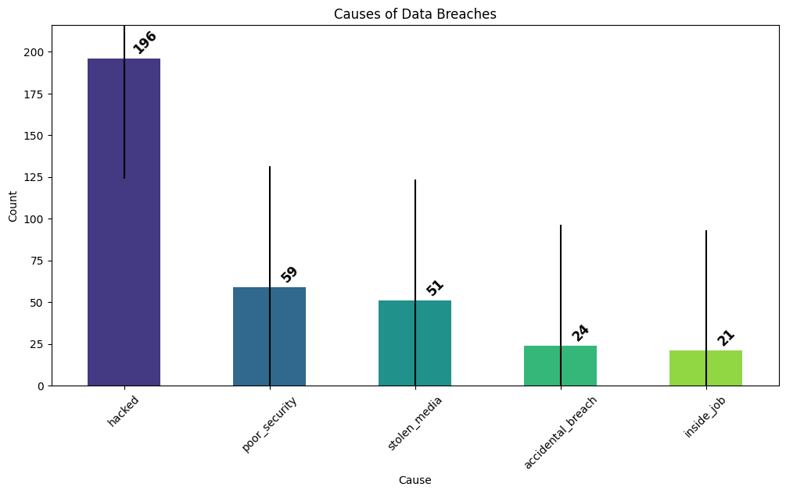
The Classes
Accenture 3A - Georgina
Notes:
Georgina

Slide 13
The Model and Results
75
81.82%
0.29
15
Accuracy Score
Validation Loss
Epochs
K-Folds
Accenture 3A - Georgina
Notes:
Georgina

Slide 14
Final Thoughts

Slide 15

Questions?

Slide 16
References
Cost of a Data Breach
Healthcare Data Breach Statistics
Health and medical data compromises
Github: https://github.com/lxwooxy/detectingdatabreach
j

